Slide 1

DISCRETE MATH
SUDOKU SOLVER
Final Review
By
Dhruv (CB.SC.U4AIE23302)
Malavika S Prasad (CB.SC.U4AIE23315)
Nandu manoj (CB.SC.U4AIE23321)
Neha R menon (CB.SC.U4AIE23324)
Geshna B (CB.SC.U4AIE23360)

Slide 2
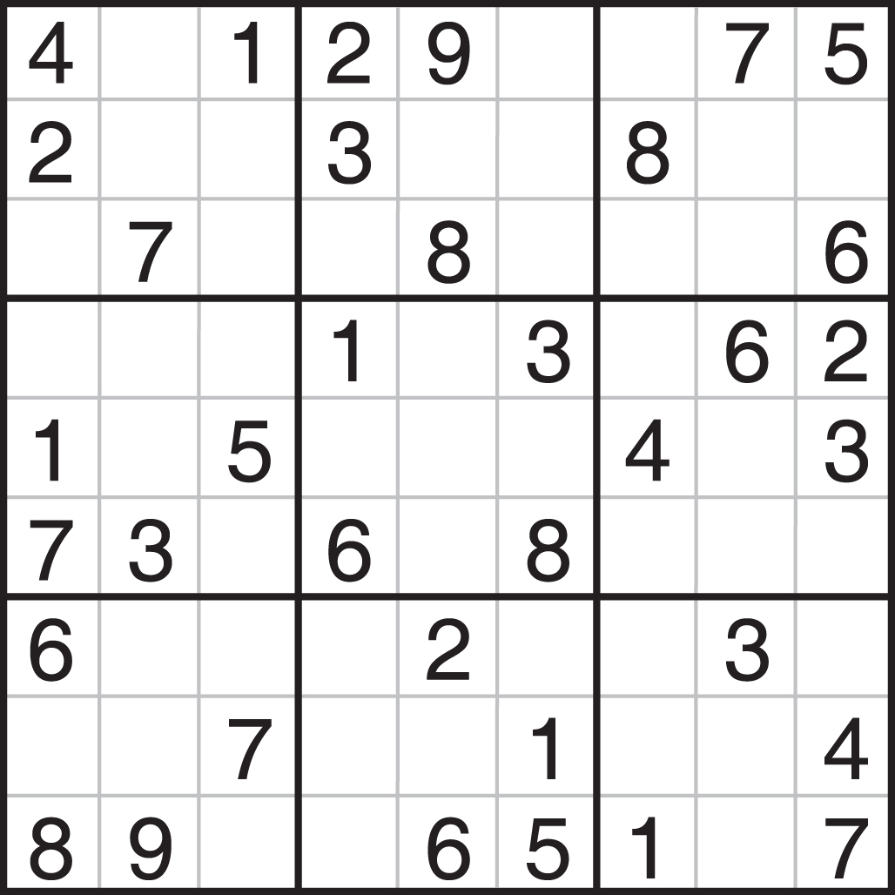
Using the images of unsolved sudoku puzzle as input and developing an AI based framework of solving sudoku puzzle.

Slide 3
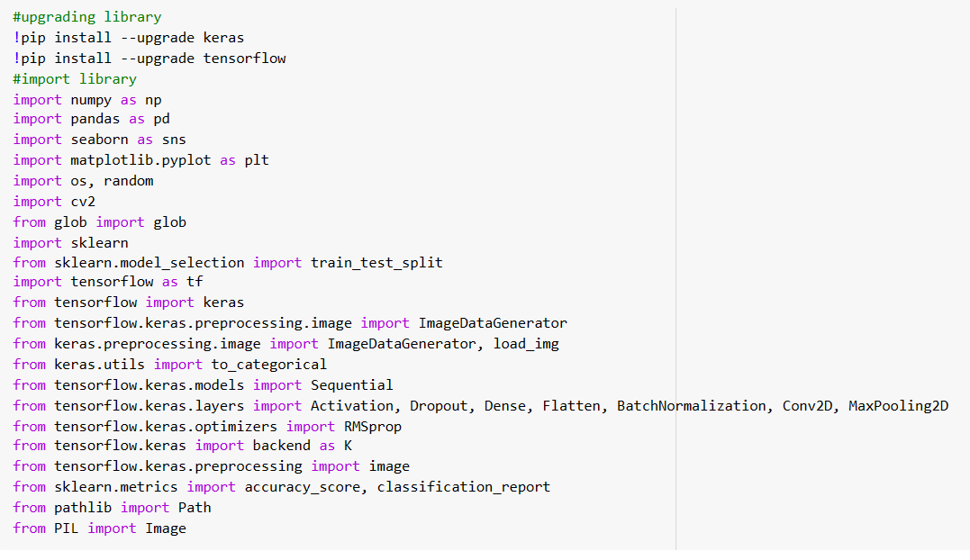
IMPORT LIBRARIES

Slide 4
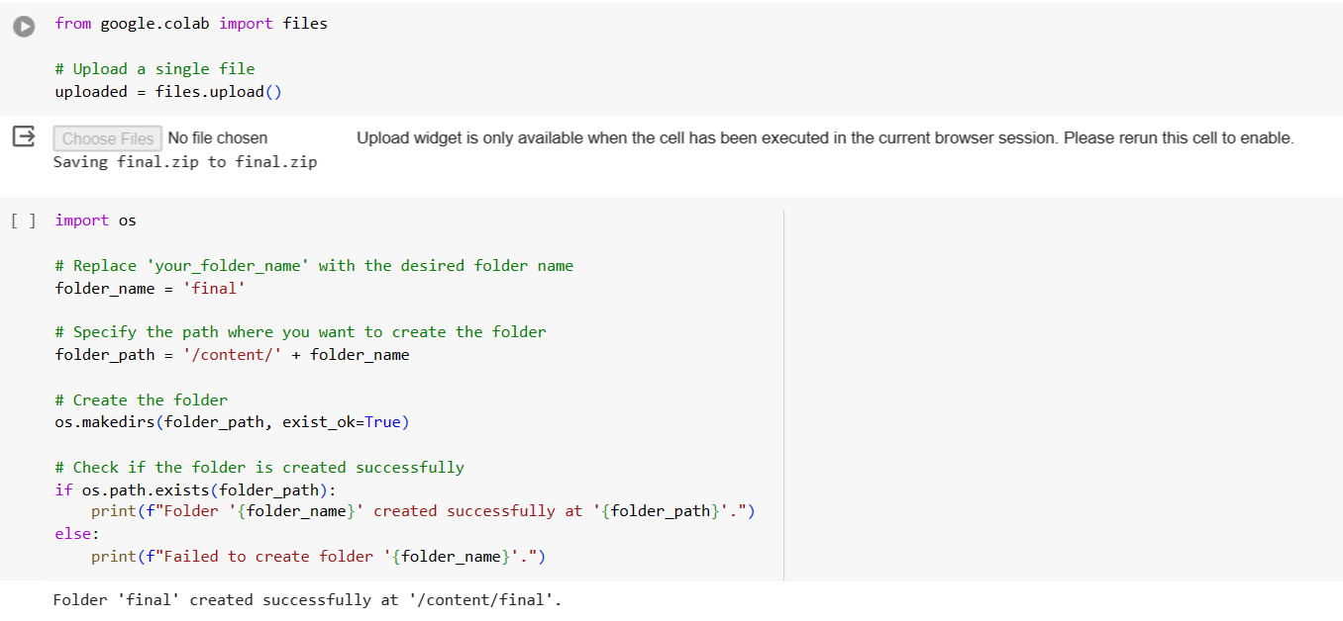
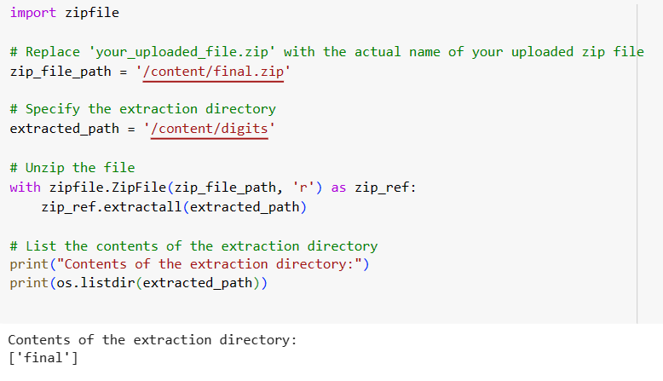
Creating digits directory

Slide 5
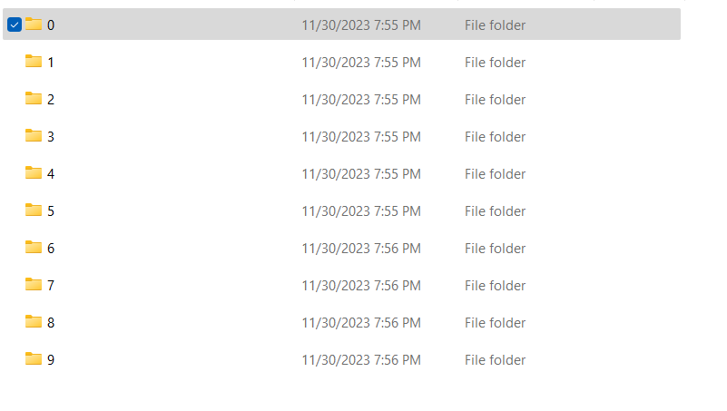
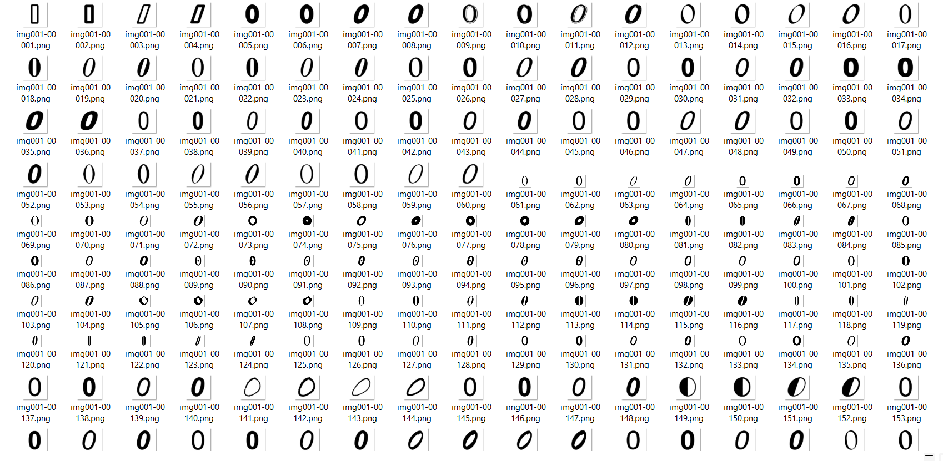
DIGIT DATASET

Slide 6
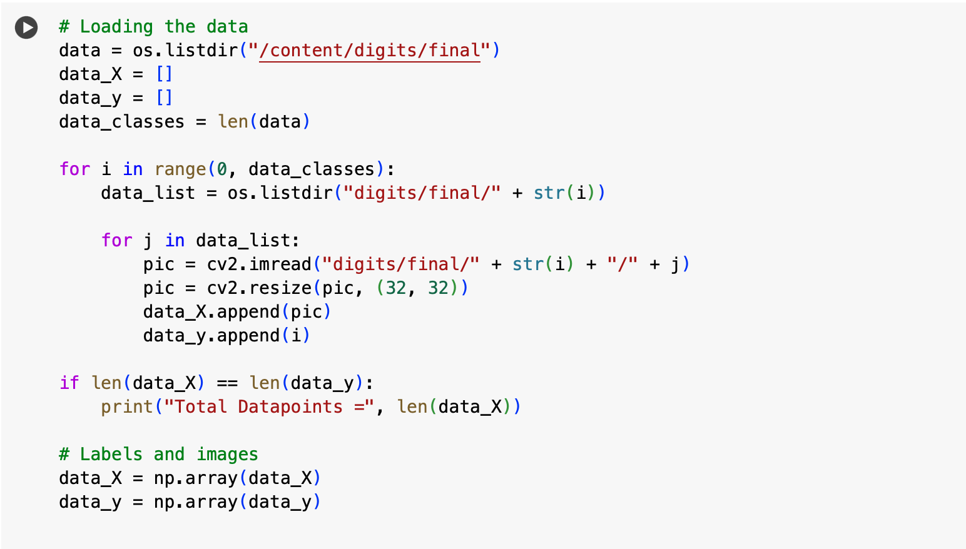

LOADING DATA
Output:

Slide 7
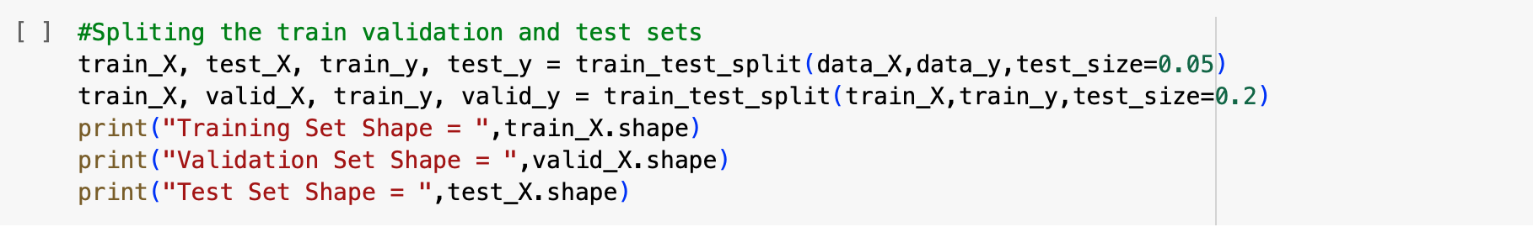
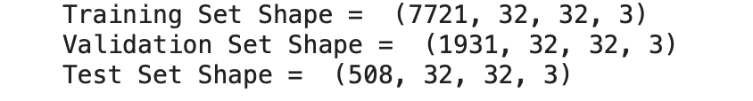
SPLITTING DATASET
Output:

Slide 8
What is pre-processing and why to pre-process the image?
Data preprocessing is a crucial step in the data analysis and machine learning pipeline. It involves cleaning, transforming, and organizing raw data into a format that is suitable for analysis or training machine learning models. The goal of data preprocessing is to enhance the quality of the data and to ensure that it is in a form that can be effectively used for the specific task.
What is neural network ?
A neural network, in the context of machine learning and artificial intelligence, is a computational model inspired by the way biological neural networks in the human brain work. Neural networks are used to learn patterns and relationships in data, and they excel at tasks such as image and speech recognition, natural language processing.

Slide 9
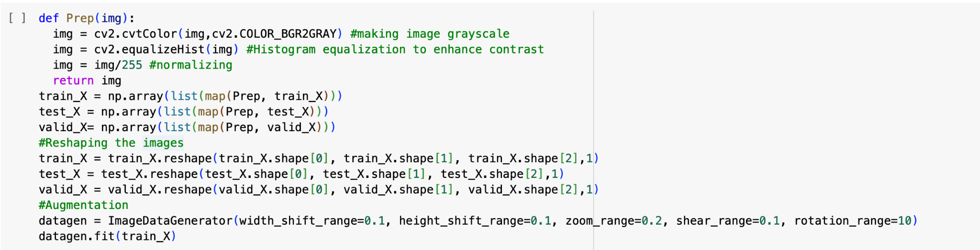
Preprocessing the images for neural net

Slide 10
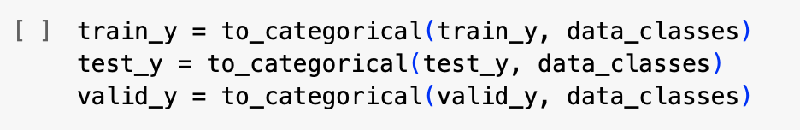
One Hot Encoding
to_categorical is a function from libraries like Keras that converts class labels into one-hot encoded vectors.
Each original class label is converted into a binary vector where the index corresponding to the class is set to 1, and all other indices are set to 0. This representation is useful for training neural networks.
data_classes is the number of classes in your classification problem. This parameter specifies the number of classes for which the one-hot encoding should be created.
Example, Let
train_y = [0, 1, 2, 1, 0, ...] #Before one-hot encoding
if we have three classes
After one-hot encoding
train_y = [
[1, 0, 0], # Corresponds to class 0
[0, 1, 0], # Corresponds to class 1
[0, 0, 1], # Corresponds to class 2
[0, 1, 0], # Corresponds to class 1
[1, 0, 0], # Corresponds to class 0

Slide 11
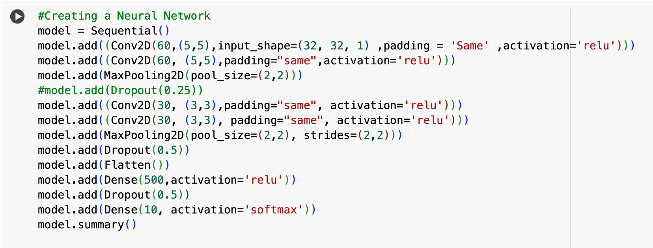
MODEL BUILDING

Slide 12
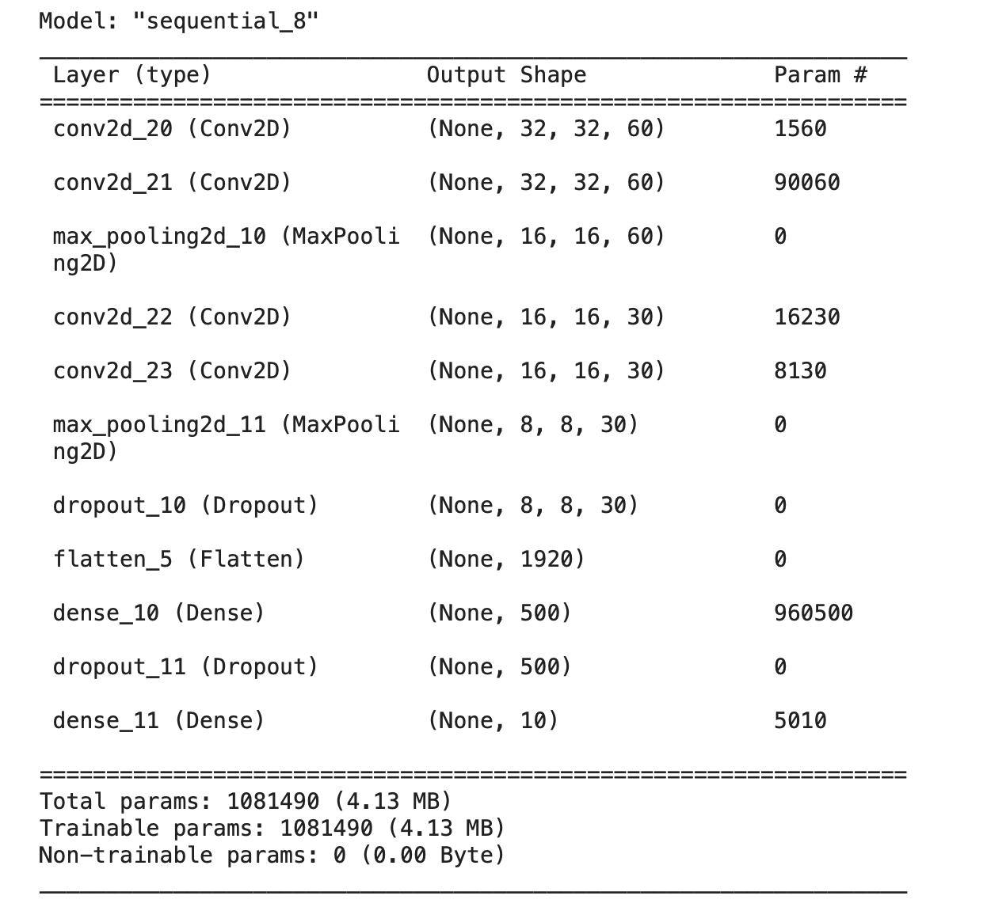
output

Slide 13
This code creates a convolutional neural network (CNN), a type of neural network particularly effective for image-related tasks
The layers created are:
Convolutional Layers (They enable the network to recognize patterns)
Max Pooling Layers (It reduces the amount of parameters and computation in the network)
Dropout Layers (introduced to prevent overfitting in neural networks, Overfitting occurs when a model learns not
only the underlying patterns in the training data but also the noise in the dataset)
Flatten Layer ( It converts the 3D output to a 1D vector, preparing the data for fully connected layers, it is
necessary because fully connected layers operate on 1D input vectors.)
Fully Connected Layers (These layers connect every neuron in one layer to every neuron in the next layer)
Output Layer (The output layer produces the final predictions)
model.summary()(This command prints a summary of the model architecture, it helps you understand the structure of the model)
The purpose of these layers and operations is to enable the neural network to learn and represent complex patterns in the input data, generalize well to unseen examples, and make accurate predictions for image classification.

Slide 14
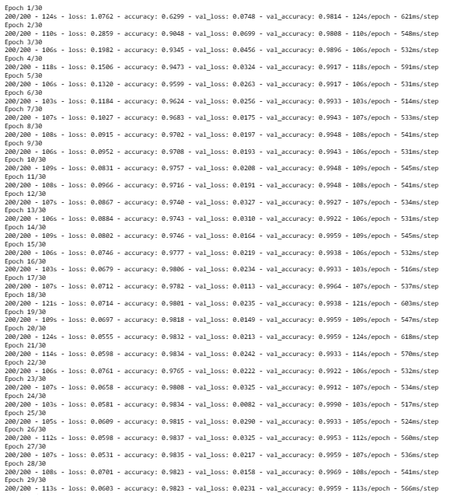
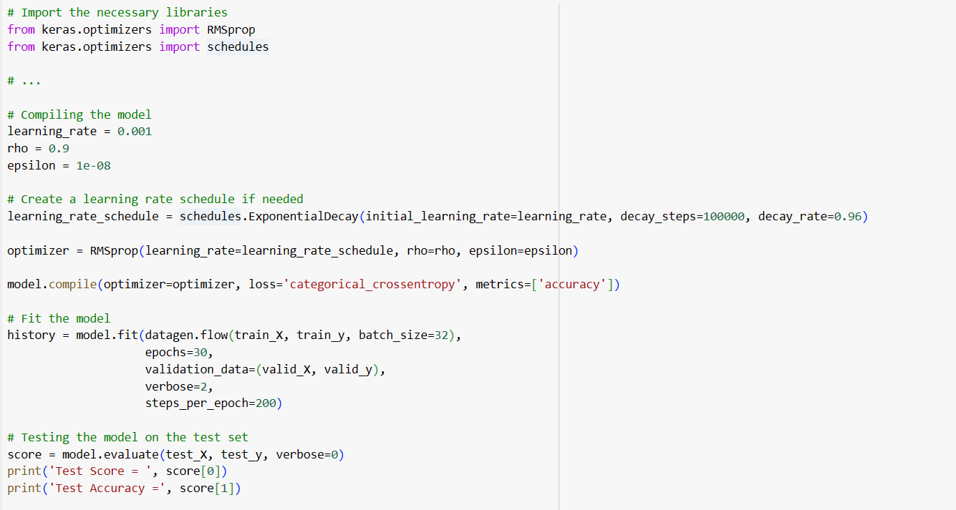
Epoch 1/30
200/200 - 124s - loss: 1.0762 - accuracy: 0.6299 - val_loss: 0.0748 - val_accuracy: 0.9814 - 124s/epoch - 621ms/step
Epoch 2/30
200/200 - 110s - loss: 0.2859 - accuracy: 0.9048 - val_loss: 0.0699 - val_accuracy: 0.9808 - 110s/epoch - 548ms/step
Epoch 3/30
200/200 - 106s - loss: 0.1982 - accuracy: 0.9345 - val_loss: 0.0456 - val_accuracy: 0.9896 - 106s/epoch - 532ms/step
Epoch 4/30
200/200 - 118s - loss: 0.1506 - accuracy: 0.9473 - val_loss: 0.0324 - val_accuracy: 0.9917 - 118s/epoch - 591ms/step
Epoch 5/30
200/200 - 106s - loss: 0.1320 - accuracy: 0.9599 - val_loss: 0.0263 - val_accuracy: 0.9917 - 106s/epoch - 531ms/step
Epoch 6/30
200/200 - 103s - loss: 0.1184 - accuracy: 0.9624 - val_loss: 0.0256 - val_accuracy: 0.9933 - 103s/epoch - 514ms/step
Epoch 7/30
200/200 - 107s - loss: 0.1027 - accuracy: 0.9683 - val_loss: 0.0175 - val_accuracy: 0.9943 - 107s/epoch - 533ms/step
Epoch 8/30
200/200 - 108s - loss: 0.0915 - accuracy: 0.9702 - val_loss: 0.0197 - val_accuracy: 0.9948 - 108s/epoch - 541ms/step
Epoch 9/30
200/200 - 106s - loss: 0.0952 - accuracy: 0.9708 - val_loss: 0.0193 - val_accuracy: 0.9943 - 106s/epoch - 531ms/step
Epoch 10/30
200/200 - 109s - loss: 0.0831 - accuracy: 0.9757 - val_loss: 0.0208 - val_accuracy: 0.9948 - 109s/epoch - 545ms/step
Epoch 11/30
200/200 - 108s - loss: 0.0966 - accuracy: 0.9716 - val_loss: 0.0191 - val_accuracy: 0.9948 - 108s/epoch - 541ms/step
Epoch 12/30
200/200 - 107s - loss: 0.0867 - accuracy: 0.9740 - val_loss: 0.0327 - val_accuracy: 0.9927 - 107s/epoch - 534ms/step
Epoch 13/30
200/200 - 106s - loss: 0.0884 - accuracy: 0.9743 - val_loss: 0.0310 - val_accuracy: 0.9922 - 106s/epoch - 531ms/step
Epoch 14/30
200/200 - 109s - loss: 0.0802 - accuracy: 0.9746 - val_loss: 0.0164 - val_accuracy: 0.9959 - 109s/epoch - 545ms/step
Epoch 15/30
200/200 - 106s - loss: 0.0746 - accuracy: 0.9777 - val_loss: 0.0219 - val_accuracy: 0.9938 - 106s/epoch - 532ms/step
Epoch 16/30
200/200 - 103s - loss: 0.0679 - accuracy: 0.9806 - val_loss: 0.0234 - val_accuracy: 0.9933 - 103s/epoch - 516ms/step
Epoch 17/30
200/200 - 107s - loss: 0.0712 - accuracy: 0.9782 - val_loss: 0.0113 - val_accuracy: 0.9964 - 107s/epoch - 537ms/step
Epoch 18/30
200/200 - 121s - loss: 0.0714 - accuracy: 0.9801 - val_loss: 0.0235 - val_accuracy: 0.9938 - 121s/epoch - 603ms/step
Epoch 19/30
200/200 - 109s - loss: 0.0697 - accuracy: 0.9818 - val_loss: 0.0149 - val_accuracy: 0.9959 - 109s/epoch - 547ms/step
Epoch 20/30
200/200 - 124s - loss: 0.0555 - accuracy: 0.9832 - val_loss: 0.0213 - val_accuracy: 0.9959 - 124s/epoch - 618ms/step
Epoch 21/30
200/200 - 114s - loss: 0.0598 - accuracy: 0.9834 - val_loss: 0.0242 - val_accuracy: 0.9933 - 114s/epoch - 570ms/step
Epoch 22/30
200/200 - 106s - loss: 0.0761 - accuracy: 0.9765 - val_loss: 0.0222 - val_accuracy: 0.9922 - 106s/epoch - 532ms/step
Epoch 23/30
200/200 - 107s - loss: 0.0658 - accuracy: 0.9808 - val_loss: 0.0325 - val_accuracy: 0.9912 - 107s/epoch - 534ms/step
Epoch 24/30
200/200 - 103s - loss: 0.0581 - accuracy: 0.9834 - val_loss: 0.0082 - val_accuracy: 0.9990 - 103s/epoch - 517ms/step
Epoch 25/30
200/200 - 105s - loss: 0.0609 - accuracy: 0.9815 - val_loss: 0.0290 - val_accuracy: 0.9933 - 105s/epoch - 524ms/step
Epoch 26/30
200/200 - 112s - loss: 0.0598 - accuracy: 0.9837 - val_loss: 0.0325 - val_accuracy: 0.9953 - 112s/epoch - 560ms/step
Epoch 27/30
200/200 - 107s - loss: 0.0531 - accuracy: 0.9835 - val_loss: 0.0217 - val_accuracy: 0.9959 - 107s/epoch - 536ms/step
Epoch 28/30
200/200 - 108s - loss: 0.0701 - accuracy: 0.9823 - val_loss: 0.0158 - val_accuracy: 0.9969 - 108s/epoch - 541ms/step
Epoch 29/30
200/200 - 113s - loss: 0.0603 - accuracy: 0.9823 - val_loss: 0.0231 - val_accuracy: 0.9959 - 113s/epoch - 566ms/step
Epoch 30/30
200/200 - 106s - loss: 0.0570 - accuracy: 0.9835 - val_loss: 0.0344 - val_accuracy: 0.9948 - 106s/epoch - 531ms/step
Test Score = 0.00896080769598484
Test Accuracy = 0.998031497001648
Epoch value analysis

Slide 15
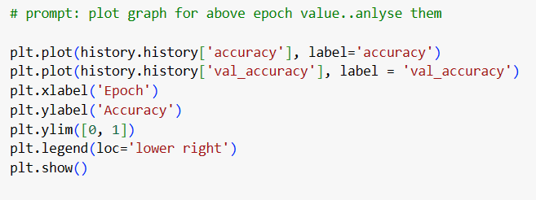
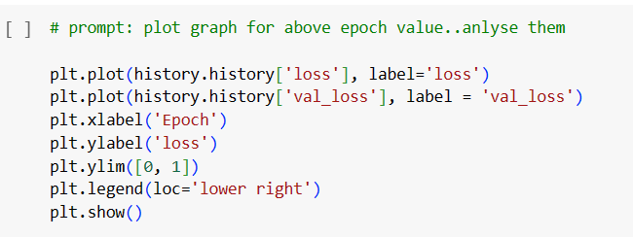
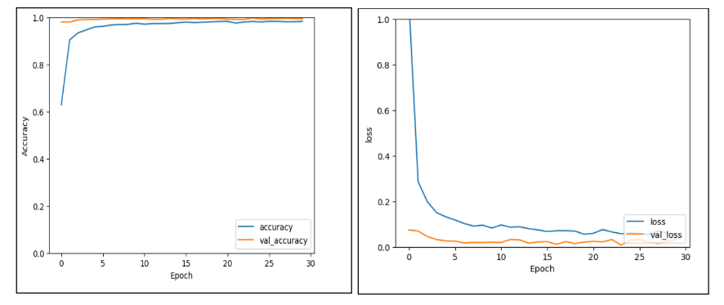

Slide 16
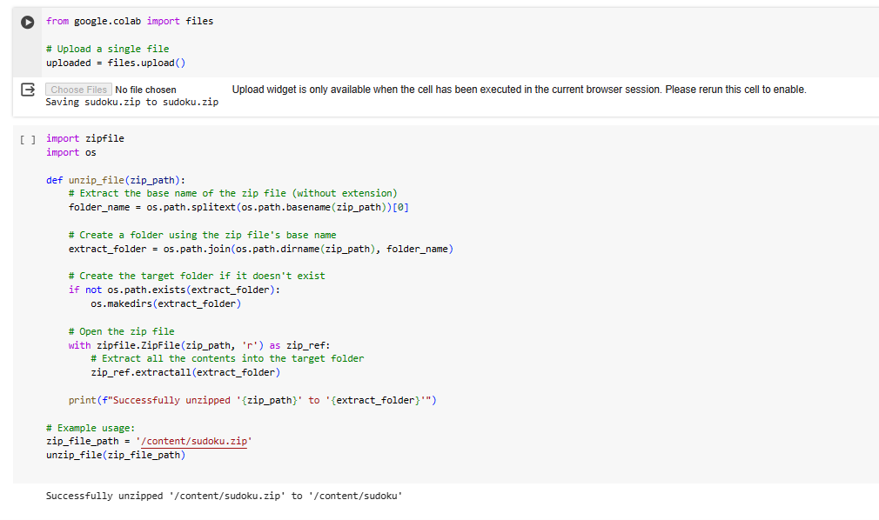
Load Sudoku dataset

Slide 17
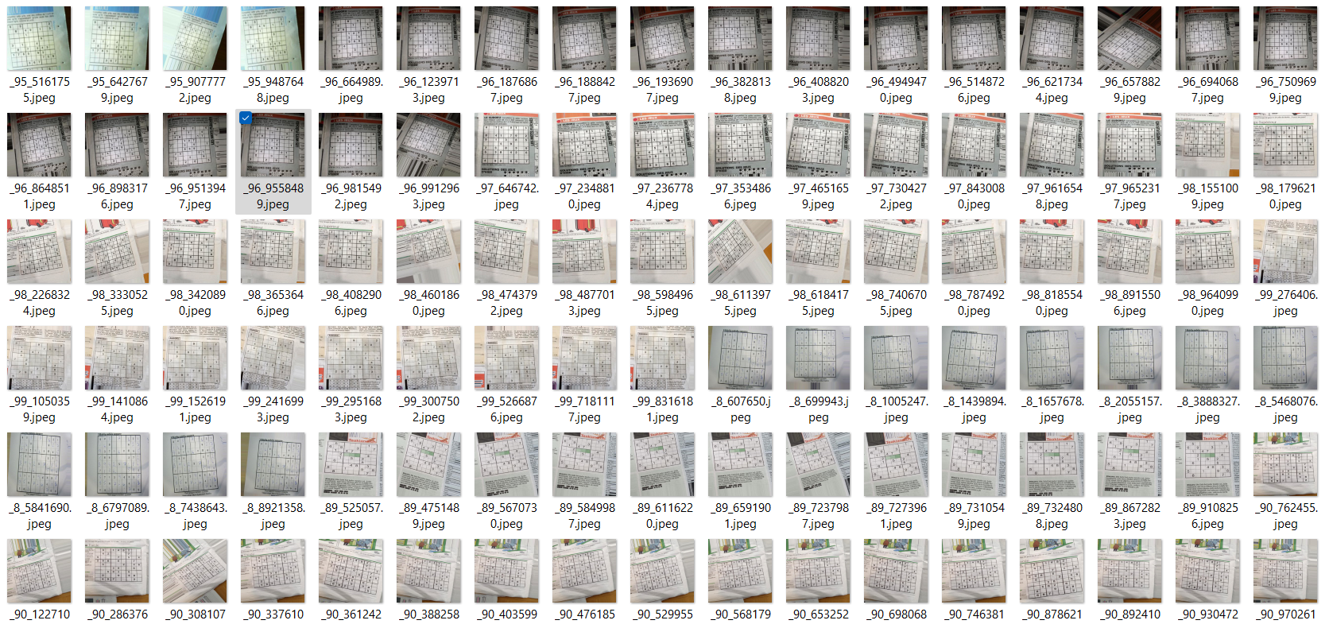

Slide 18
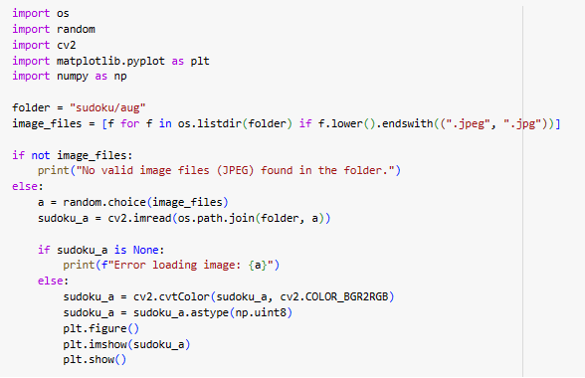
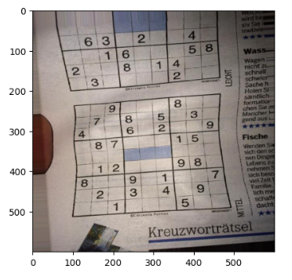
Select a random image from file and display the image

Slide 19
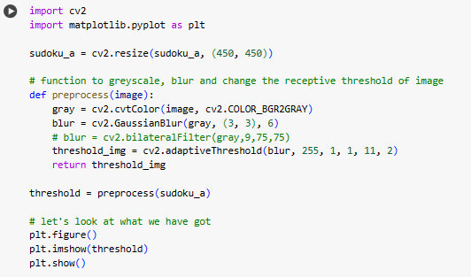
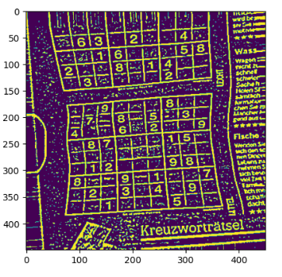
Pre-process image

Slide 20
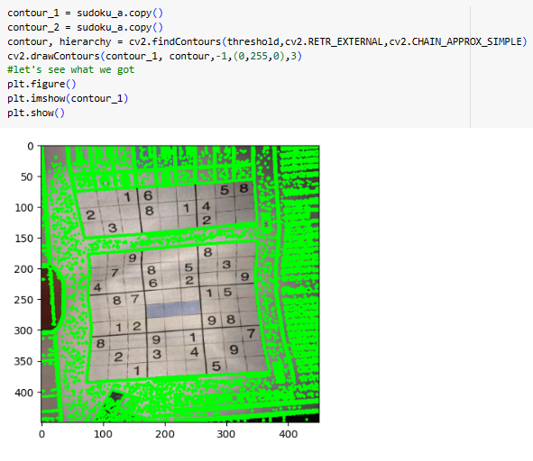
Apply Contour

Slide 21
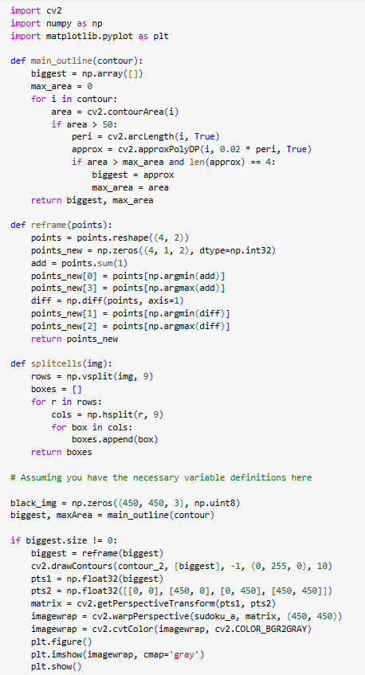

Slide 22
PURPOSE
REFRAME
This function is responsible for rearranging the vertices of a sudoku grid in a specific order.
It ensures that the points are ordered as top-left, top-right, bottom-left, and bottom-right, which is useful for later perspective transformation.
MAIN OUTLINE
This function is designed to find the largest contour in the list of contours (obtained from cv2.findContours).
It looks for the contour with the maximum area, and if the area is above a certain threshold (50 in this case), it approximates the contour to have only four vertices.
The goal is to identify the outer boundary of the Sudoku puzzle grid.
SPLIT CELLS
This function is intended to split the Sudoku puzzle grid into individual cells. It assumes that the input image (img) is a 9x9 grid, and it splits the image into 81 smaller cells (9 rows x 9 columns).
The resulting list of cells can be further processed to extract information from each cell, such as detecting digits.

Slide 23
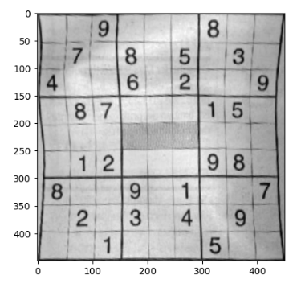
Original
Final

Slide 24
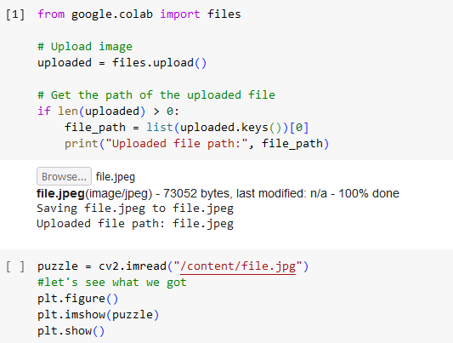
IMPORTING THE PUZZLE

Slide 25
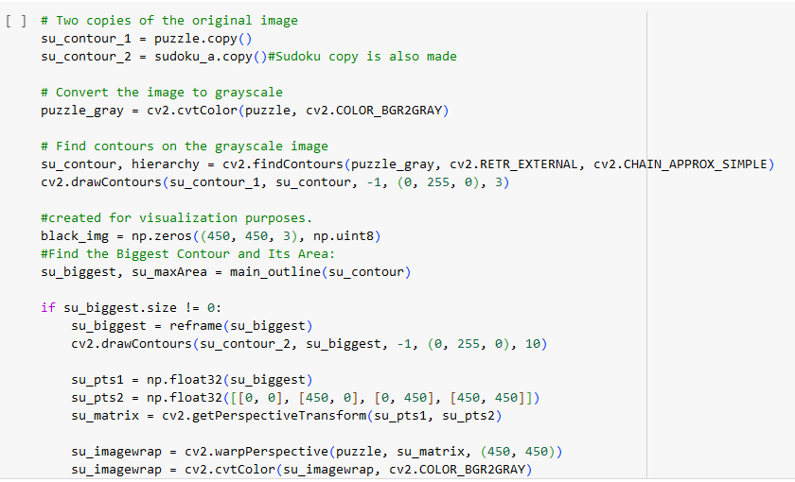

Slide 26
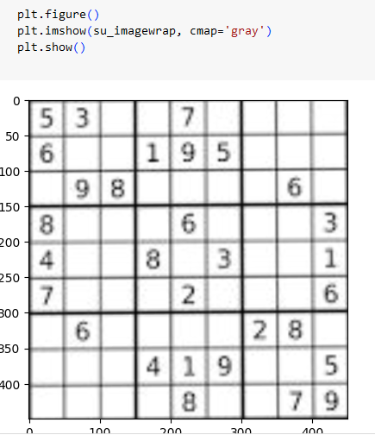
Display image

Slide 27
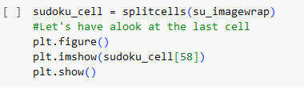
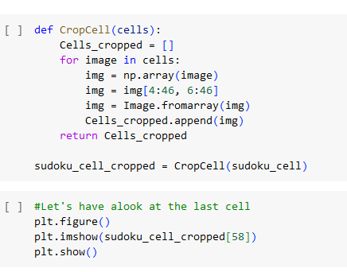
CELL SPLITTING AND CLASSIFY THE DIGITS

Slide 28
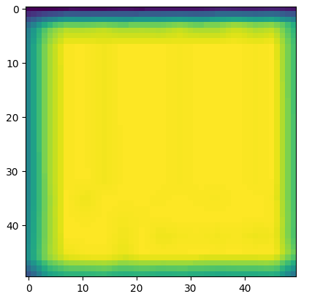
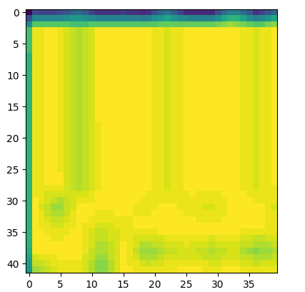
SPLITTED CELL
CROPPED CELL

Slide 29
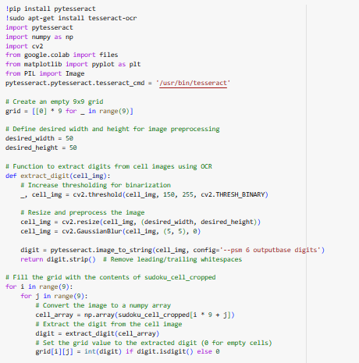
OCR

Slide 30
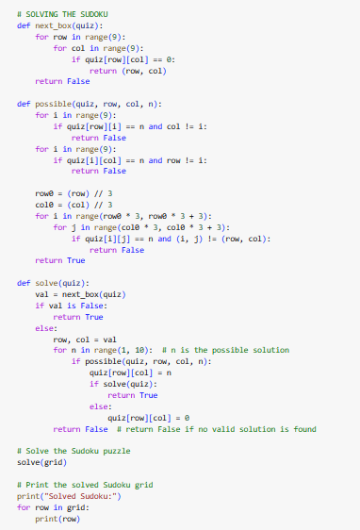
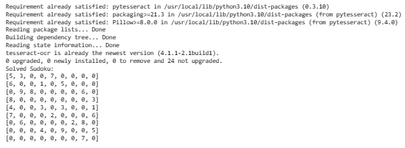
Generate array from image and generate a solved array

Slide 31
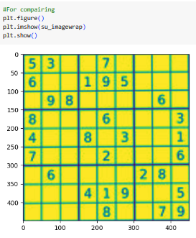
Comparison and final image display

Slide 32
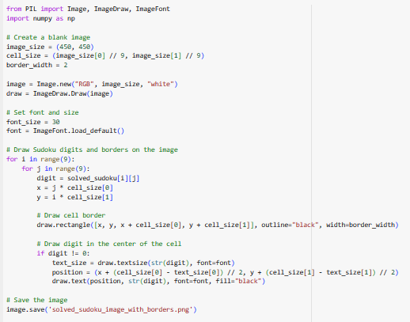
Solved sudoku image Generation

Slide 33
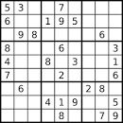
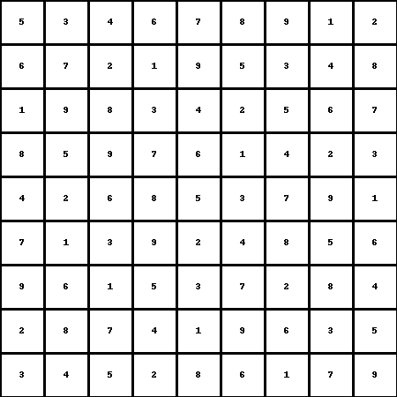
Original sudoku
Final solved sudoku

Slide 34
Thank you!

